Slide 1
Summary
Intro and Overview
Research and findings
Theoretical Discussion and Github
Conclusion

Slide 2
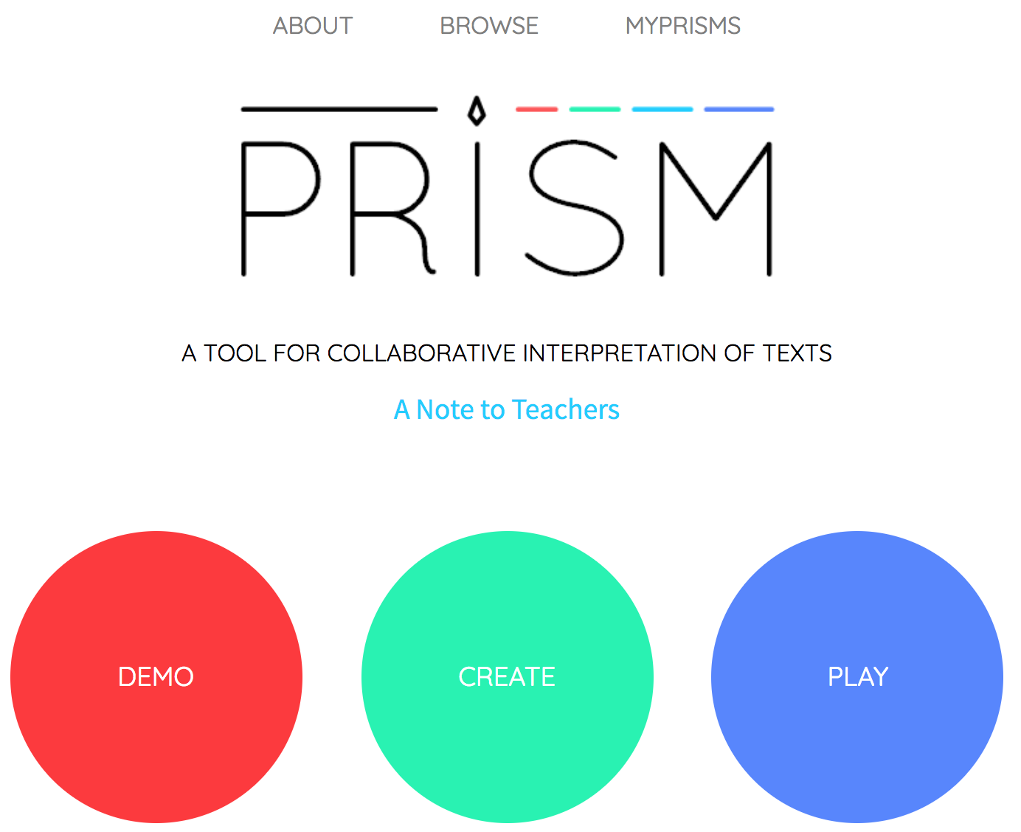
About PRISM
Main goals
What does it seek to accomplish
Teachers & Students
How is it funded - Melon Foundation
Schools & Universities
Text Visualization tool

Slide 3
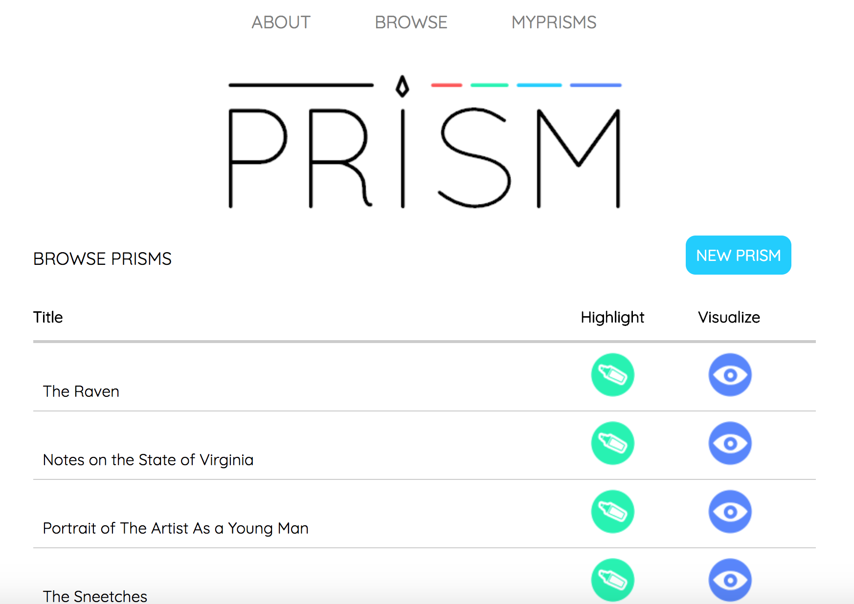
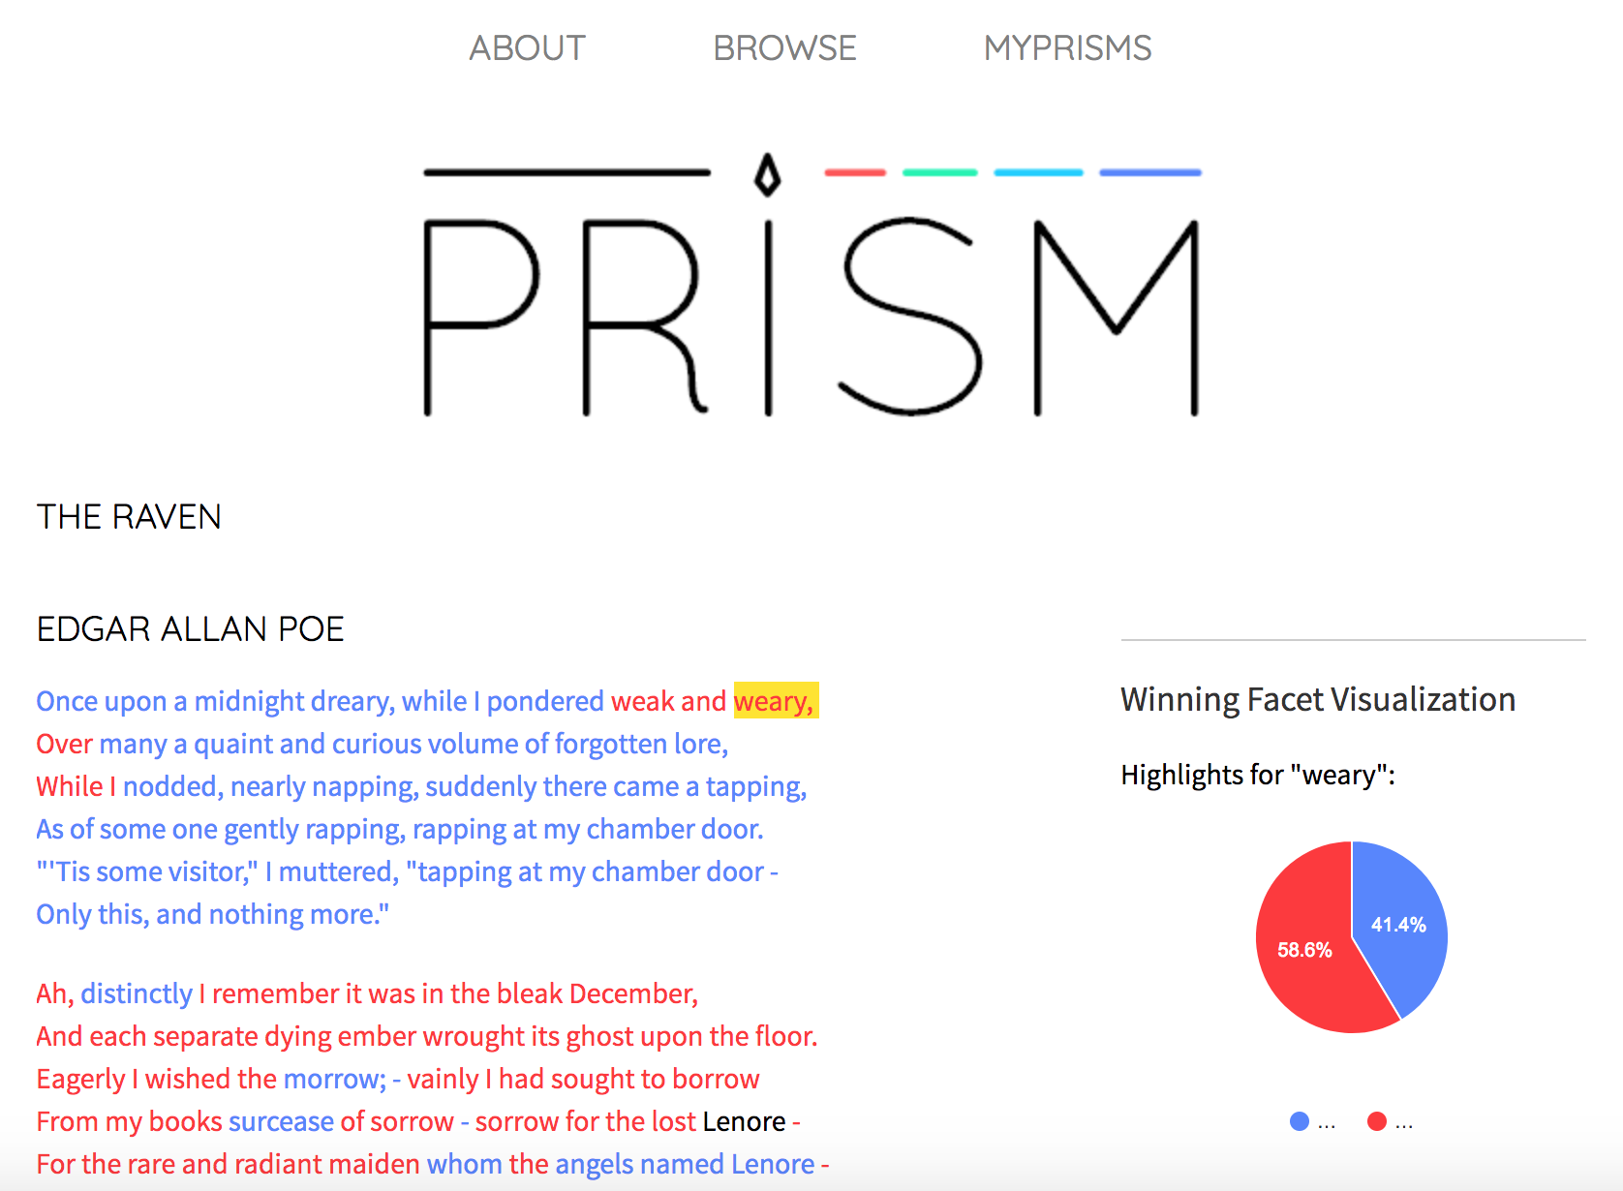
Main Features

Slide 4
Our PRISM
http://prism.scholarslab.org/prisms/e7e1a0b2-0aad-11e8-ab56-005056b3784e/visualize?locale=en

